Slide 1

Generating Synthetic Financial Data with LLMs
Darren Dcunha
Charan Kumar Pathakamuri
A framework for creating high-fidelity synthetic data using advanced language models for financial applications

Slide 2




Why We Need Synthetic Data
Data Quality Challenge
Missing Information
New, illiquid, or restricted assets lack sufficient data
Financial models require high-quality historical returns
Simulation Need
Synthetic data fills gaps for hypothetical scenarios

Slide 3

Synthetic Financial Data Explained
Artificial Return Sequences
Statistical Integrity
Must preserve volatility, skew, kurtosis of real assets
Computer-generated data mimicking financial asset behavior
Key Applications
Stress testing, backtesting, scenario simulation

Slide 4





LLMs as Data Generators
Natural Language Input
Zero-Shot Generation
Flexible Structure
Accept prompts like "volatile asset with fat tails"
No retraining needed for new scenarios
Adaptable to diverse financial behaviors
Quality Control
Prompt engineering + scoring ensures reliability

Slide 5
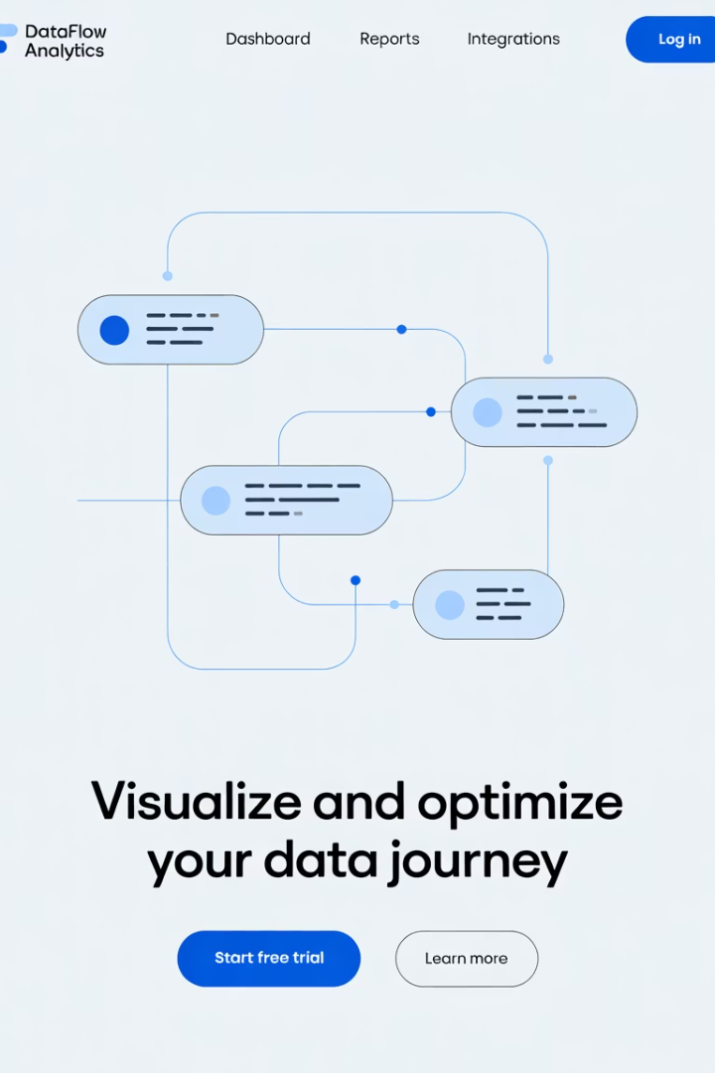




System Architecture
Real Data
Initial financial returns
Prompt Generator
Creates statistical specifications
GPT Model
Generates synthetic returns
Statistical Scoring
Validates or triggers refinement

Slide 6
Data Collection & Metadata
Source: Yahoo Finance via yfinance Python API
Assets: Daily OHLC data from stocks like AAPL, MSFT, AMZN
Fields Collected: Date, Open, High, Low, Close, Volume, Adj Close
Calculated Feature: Log Return = ln(Close_t / Close_{t-1})
Metadata: Includes ticker symbol and optional sector info
Usage: Used for windowed return extraction, prompt generation, and evaluation

Slide 7




GPT: Our Model of Choice
Superior Instructions
Industry-leading comprehension vs. open-source
Performance
High-quality, rapid generation
Integration
Simple API implementation
Iteration
Excels at prompt-based refinement

Slide 8










Statistical Evaluation Metrics
Standard Deviation
Mean
Measures volatility
Average return value
Skewness
Captures return asymmetry
KS-Test
Evaluates distribution similarity
Kurtosis
Quantifies tail risk

Slide 9
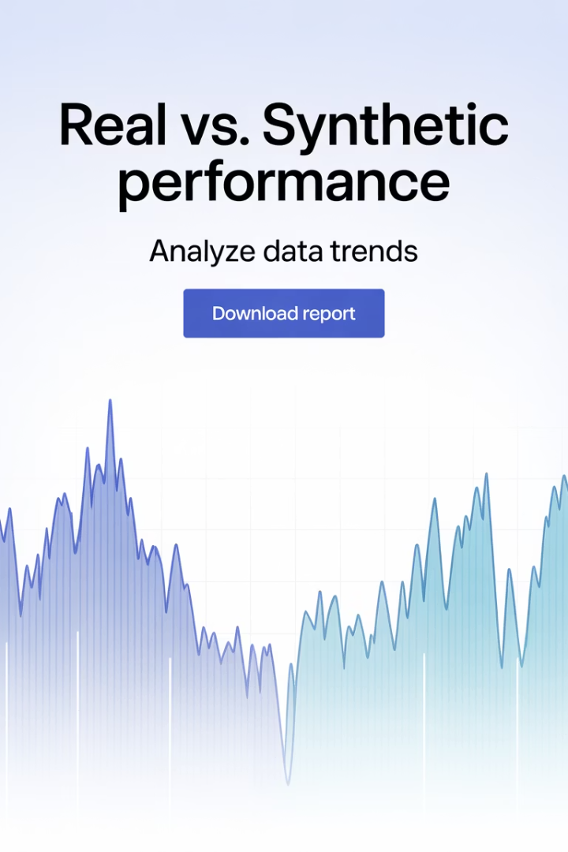
Real vs Synthetic Comparison
Metric
Real Data
Synthetic Data
Observation
Std. Dev
0.027
0.0024
Too smooth
Skew
-1.5
-0.26
Not asymmetric enough
Kurtosis
6.6
-1.1
Missing fat tails

Slide 10
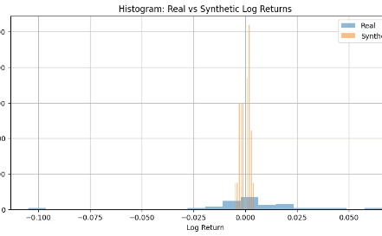
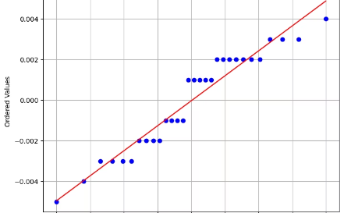
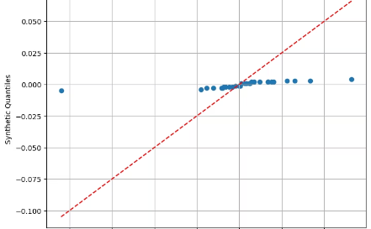
Visual Diagnostics
Histogram Comparison
Distribution shape analysis
Q-Q Plot: Synthetic vs Normal
Normality assessment
Q-Q Plot: Real vs Synthetic
Direct comparison of distributions

Slide 11








Reinforcement Prompting Loop
Initial Prompt
Generation
Statistical specifications provided
LLM creates synthetic returns
Refinement
Evaluation
Prompt rewritten based on specific failures
Statistical analysis identifies issues

Slide 12

Monte Carlo Simulation Case Study
Visualization
Percentile Analysis
Fan chart showing distribution of final prices
Path Simulation
Compute 5th, 50th, and 95th outcomes
Input Generation
1,000 price paths over 60 days
Valid synthetic returns feed GBM model

Slide 13

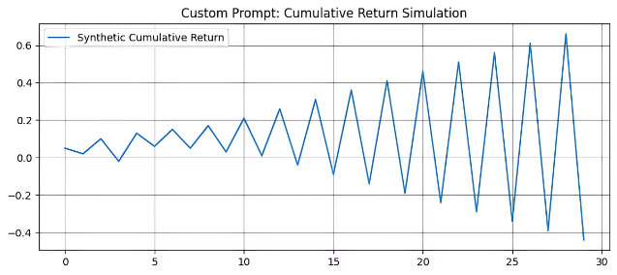
Use Case: Prompt-Driven Simulation
📈 Generated synthetic returns using a custom prompt
🔁 Output was visualized as a cumulative return series
💼 Can feed this output into a Monte Carlo engine for future price paths
🧾 Prompt: "A high-risk crypto asset with extreme volatility and fat tails"
🎯 Demonstrates user-defined behavior via natural language control
📊 Useful for scenario analysis, trading strategy testing, or synthetic portfolio simulation

Slide 14
Advantages & Limitations
Pros
Cons
Flexible, prompt-based approach
Needs feedback for statistical realism
Low-code, fast iteration
Struggles with tail modeling
Works with limited real data
No multivariate correlation

Slide 15




Alternative Financial Models
Model
Purpose
FinBERT
Sentiment and classification
FinGPT
Domain-tuned GPT for finance
FinLang
Financial QA / logic tasks
Mistral
Local GPT-style alternative

Slide 16






Limitations & Future Work
Future Directions
Fine-tuned LLMs, code generation, RAG, GUI
Missing Correlation
No modeling between multiple assets
Statistical Limitations
GPT struggles with precise distributions

Slide 17





Strategic Use Cases
Stress Testing
Evaluate new portfolios under extreme conditions
AI Model Training
Bootstrap data for machine learning models
Scenario Planning
Generate business cases for strategic planning
Compliance-Friendly
Model without exposing sensitive real data

Slide 18

Final Takeaway
3
1
10x
Key Requirements
Core Truth
Potential Impact
Statistical scoring, prompt refinement, visual evaluation
Synthetic complements real data—never replaces it
When properly implemented with feedback loops

